Slide 1
The Role of Bioenergy in the Circular Economy
Matt Nelson
Team Leader – Waste to Energy Sustainability Victoria
26 October 2023

Slide 2

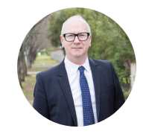
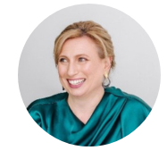
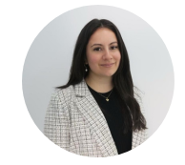
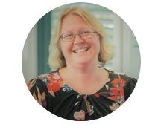
The Panel
text
Ragini Prasad
Executive Officer, Victorian Bioenergy Network
Tiana Nairn
Group Manager Policy,
LMS Energy
Michael Renehan
CEO, Gaia EnviroTech
Jill Riseley
Executive Director, Deloitte
Stephanie Salinas
Manager Waste to Energy Services, Yarra Valley Water

Slide 3
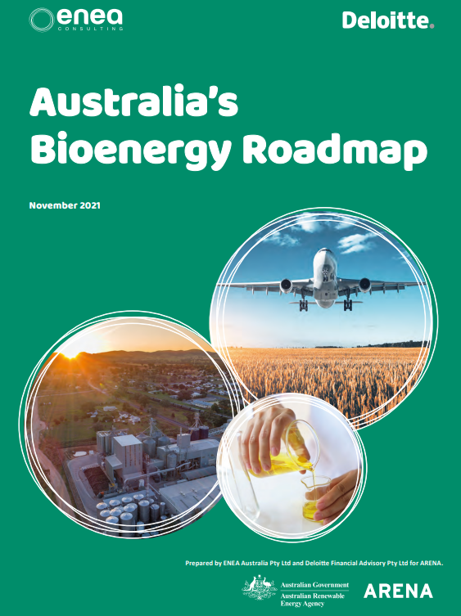

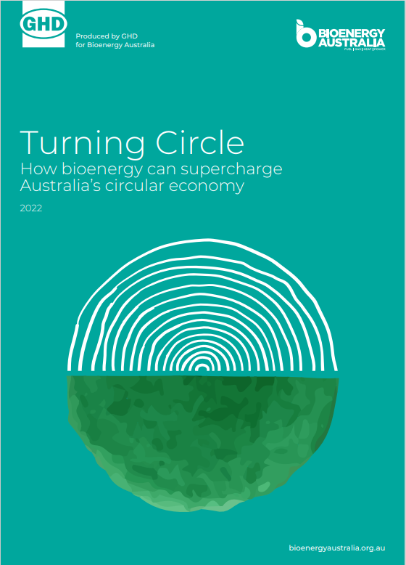
The Time For Bioenergy Is NOW
“We are at a crossroads. The decisions we make now can secure a liveable future. We have the tools and know-how required to limit warming. I am encouraged by climate action being taken in many countries. There are policies, regulations and market instruments that are proving effective. If these are scaled up and applied more widely and equitably, they can support deep emissions reductions and stimulate innovation.” –Former IPCC Chair Hoesung Lee

Slide 4
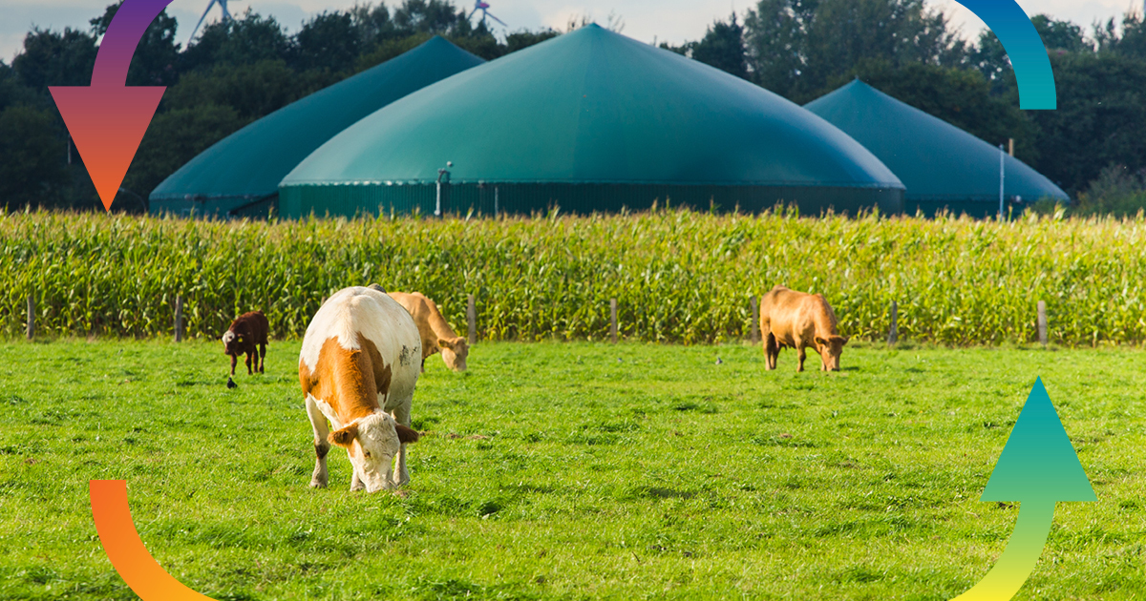
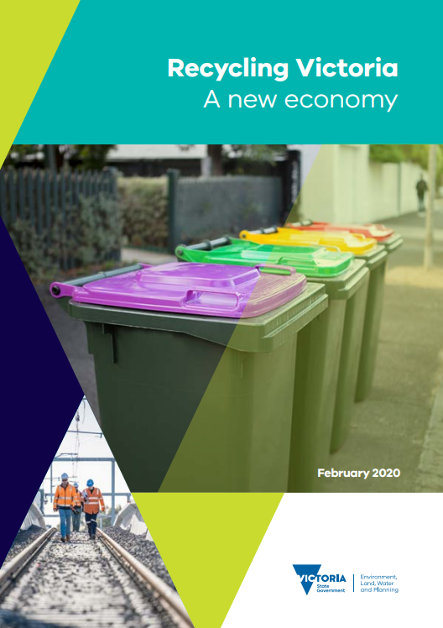


Victorian Government Bioenergy Support
$10 million Bioenergy Fund
text

Slide 5
text
What is the role of Bioenergy in the Circular Economy?

Slide 6
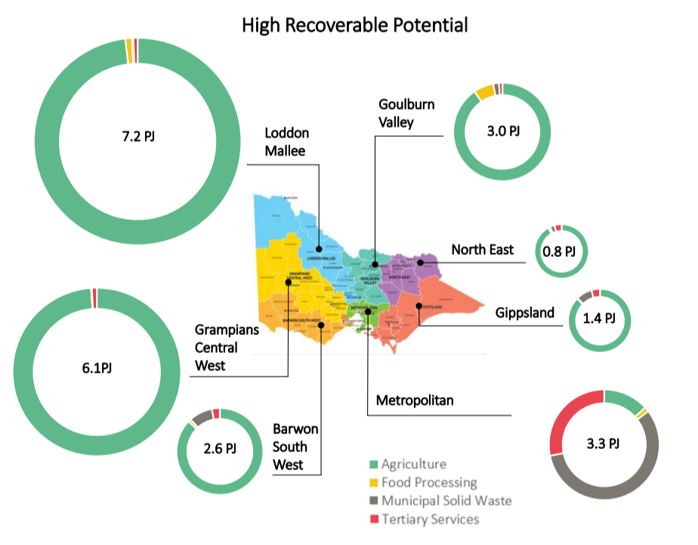
text
Getting started –
What’s needed to kick off a bioenergy project?
Regional breakdown of Victoria’s high recoverable biogas potential from anaerobic digestion

Slide 7
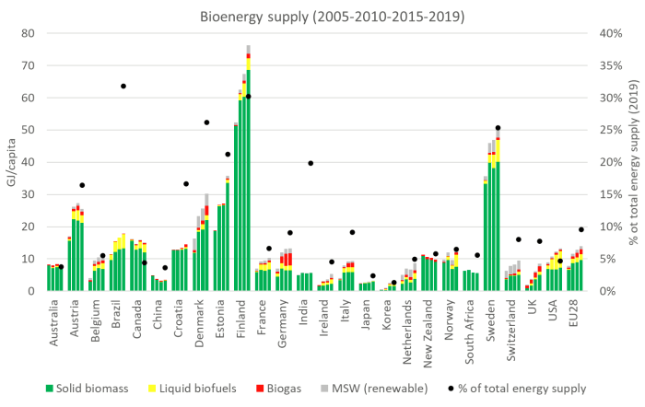
text
The systemic interventions needed to turn Victoria into a world class bioeconomy
Evaluation of bioenergy supply per capita in the IEA Bioenergy member countries (Data source: IEA World Energy Balances and Renewables Info 2021)

Slide 8
Audience Q/A
text

Slide 9



Act Now – Become Part Of The Movement
text
Invest@sustainability.vic.gov.au
Executive_Officer@vicbioenergy.com.au
Admin@bioenergyaustralia.org.au

Slide 10

Act Now – Victorian Networking Event
text
November 28, 2023
Technology Park, Federation University
Ballarat, Victoria
Executive_Officer@vicbioenergy.com.au

