Slide 1
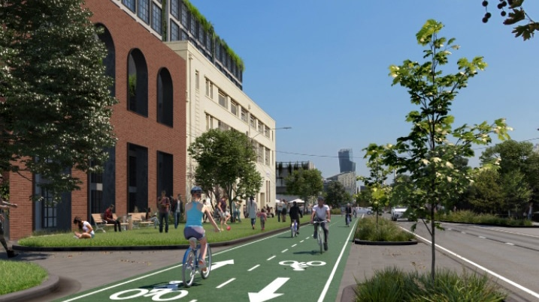
Waste Collection Solutions in a
Vehicle Free City
Waste Expo, Melbourne 2023
Maree Marshall – Director
Waste Management and Circular Economy
WSP Australia
Maree.Marshall@wsp.com

Slide 2
Notes:
Acknowledgement of country (1 min)

Slide 3
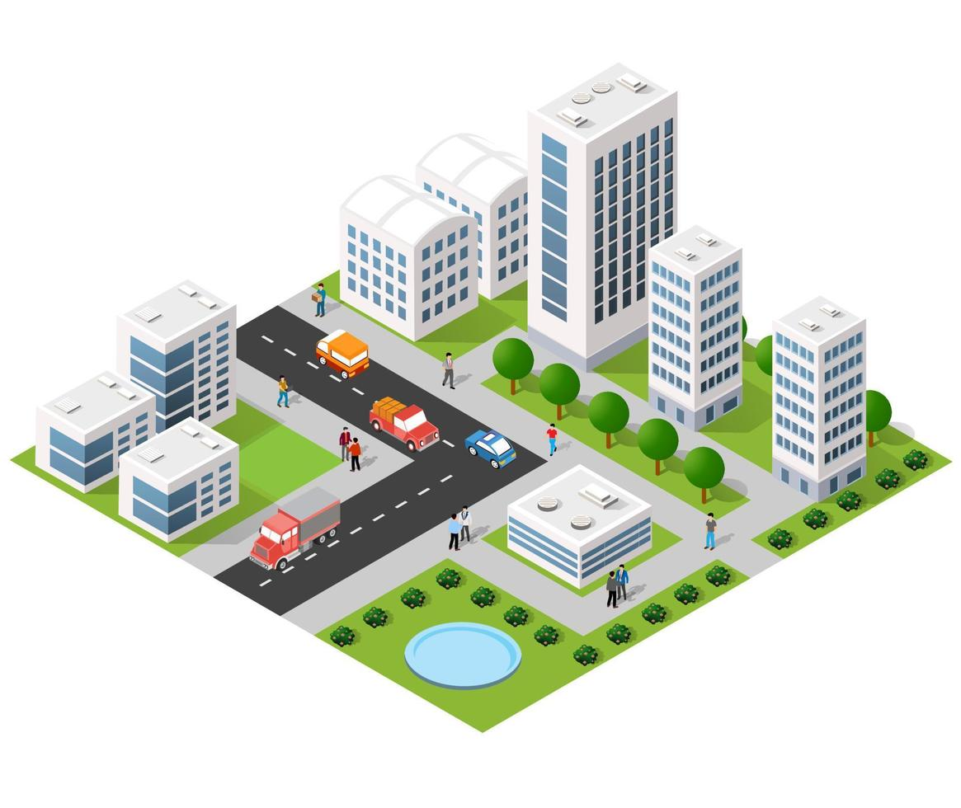
Vehicle Free Cities
Cities around the world are becoming vehicle-free, but how do we design for waste collection and deliveries?
Cities which we looked at for inspiration include:
Belgium (Ghent)
Germany (Heidelberg)
Arizona (Tempe)
Spain (Barcelona)
Netherland (Utrecht)

Slide 4
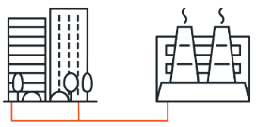
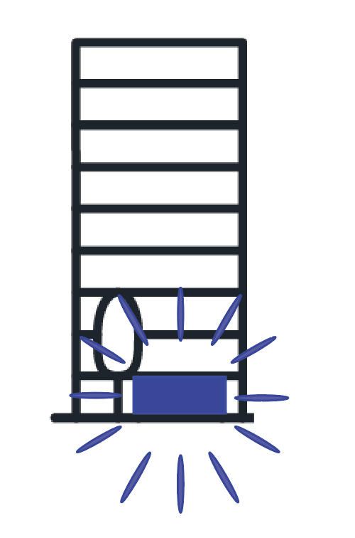
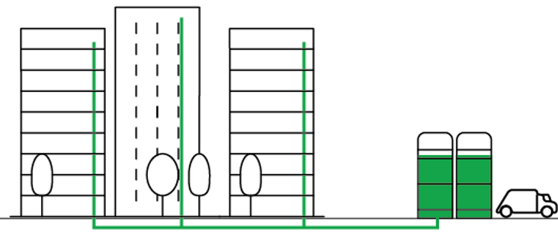
Waste System Options
Vacuum Waste Systems
Consolidated Waste Collection Docks
Organic Piped Network
Circular Economy Hub

Slide 5
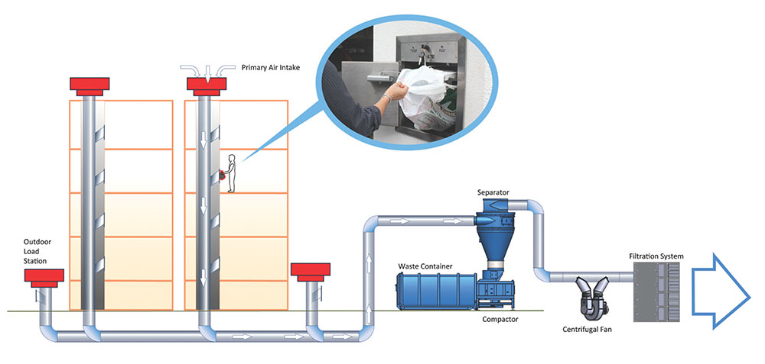
Vacuum System

Slide 6
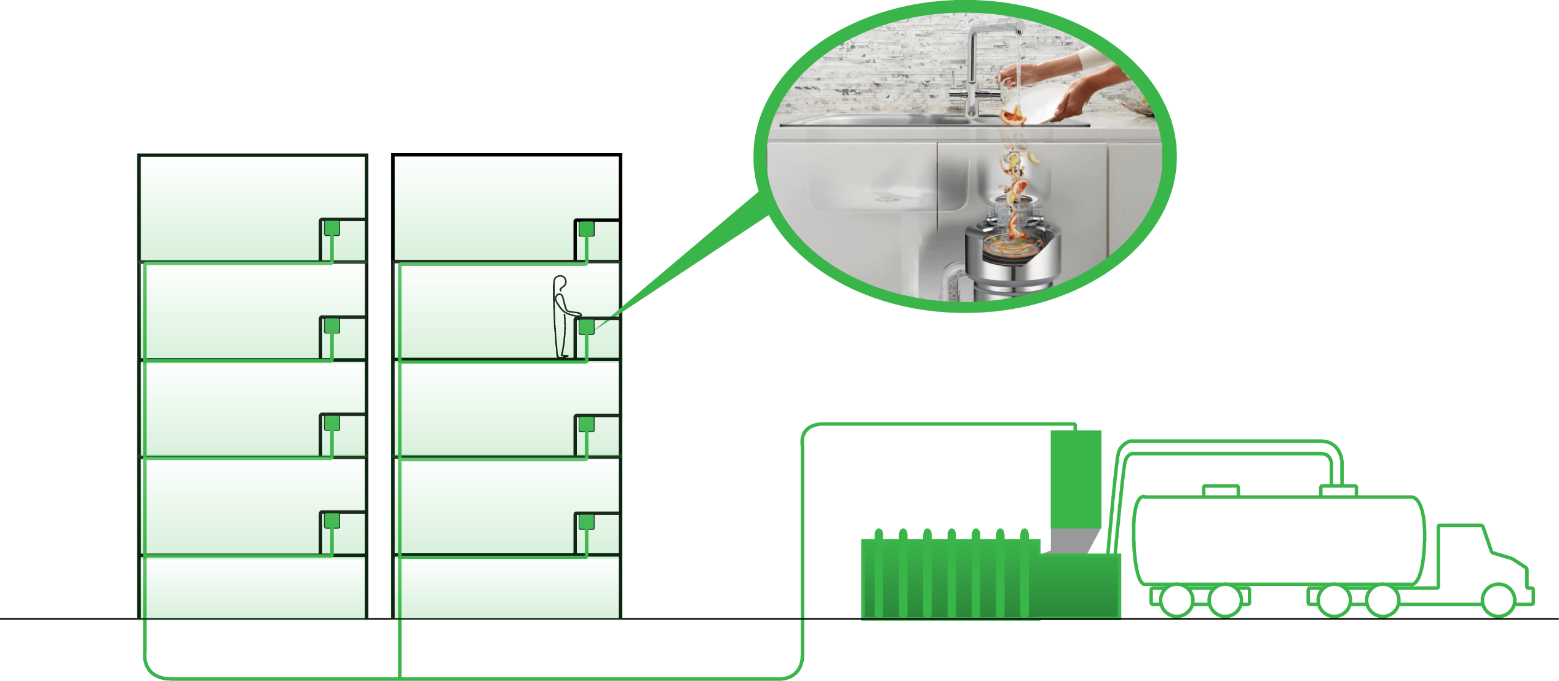
Piped Organics

Slide 7
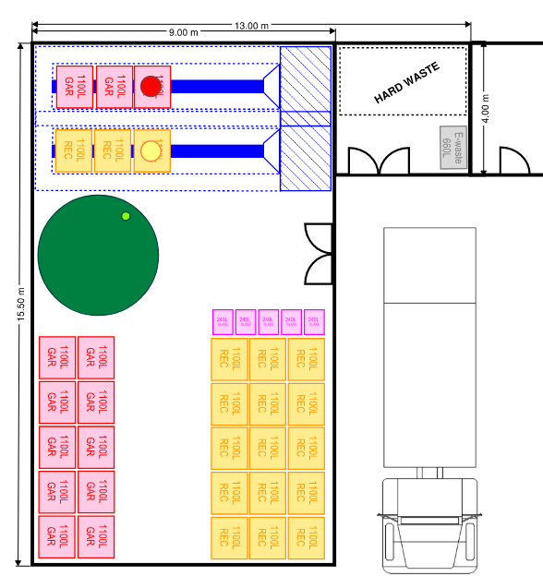
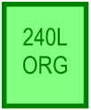
Consolidated Docks

Slide 8
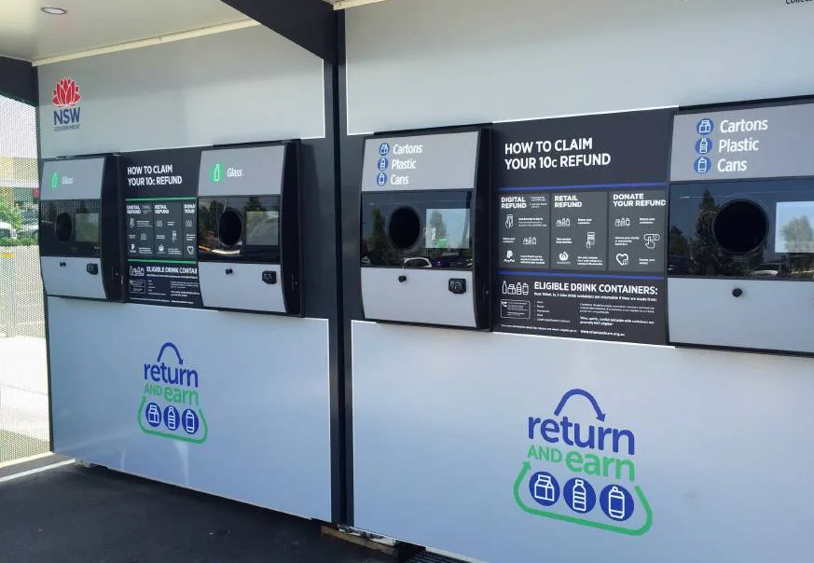
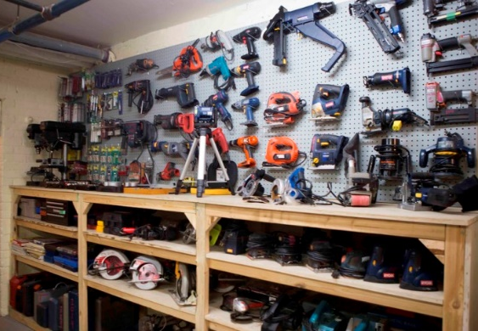
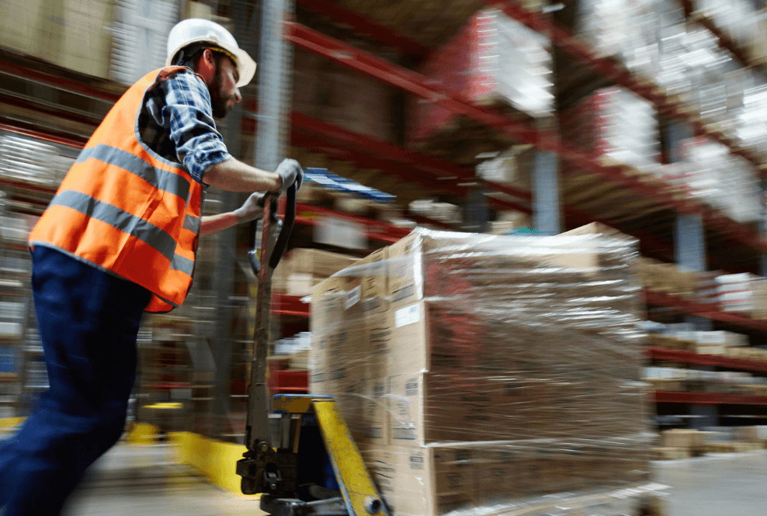
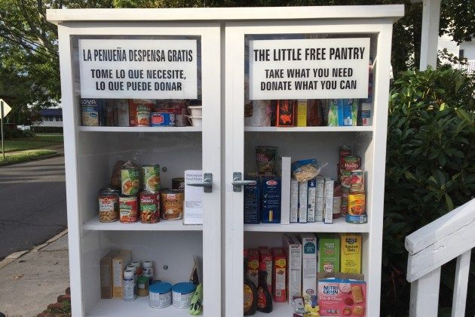
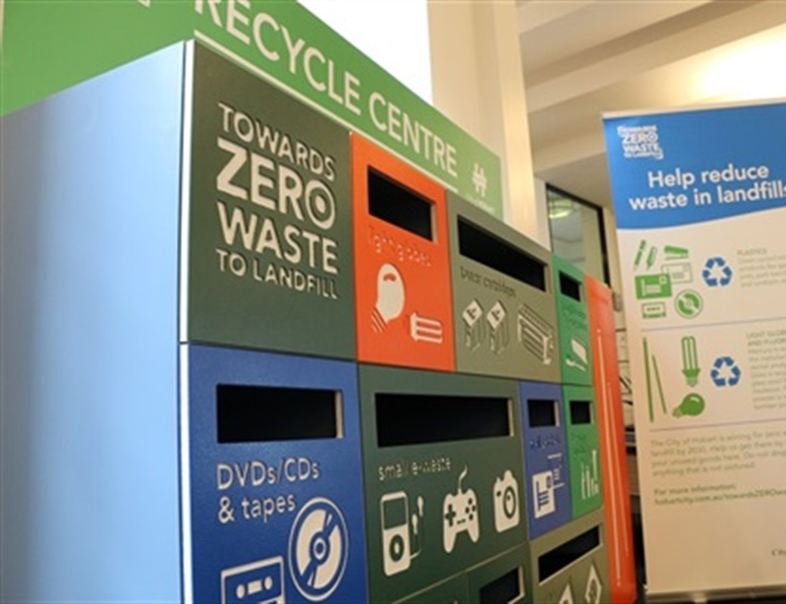
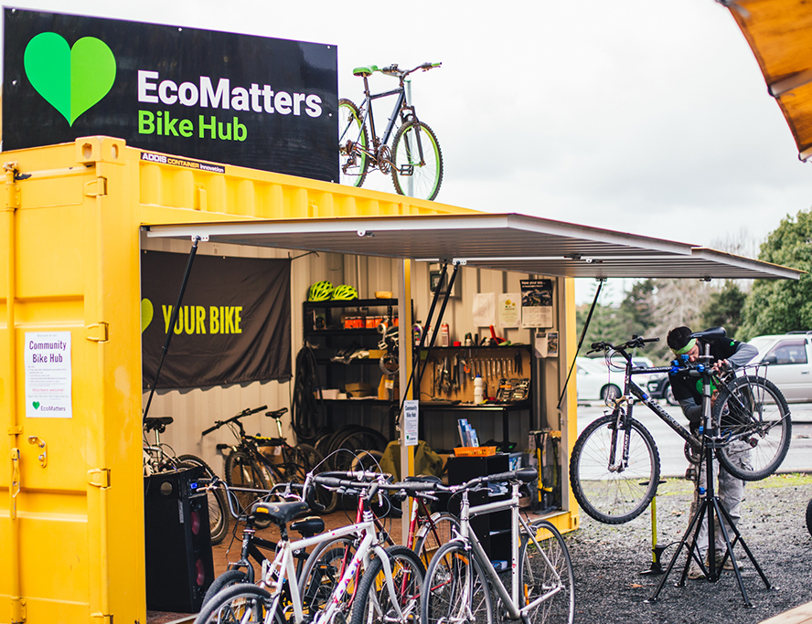
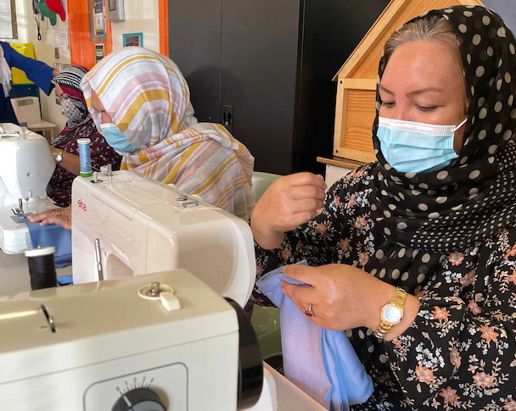
Urban Resource Recovery Centre (URRC)
“A URRC (Circular Economy Hub) offers an opportunity rethink how we value waste while also offering improved community facilities”
Community engagement
Local employment
Reduction of transport and emissions
Container Deposit
Tool Library
Employment and Training
Little Pantry
Specialty Recycling
Bike Repair
Repair Cafe
Repair Café & Education

Slide 9
Waste Streams
Category | Stream | Vacuum | Consolidated Docks | Organic Pipe | CE Hub
CORE | Garbage | ✓ | ✓
 | Commingled Recycling | ✓ | ✓
 | Food Organics | ✓ | ✓ | ✓
 | Glass | ✓ (mixed) | ✓
 | Soft Plastics | ✓ | ✓ |  | ✓
 | Cardboard | ✓ | ✓ |  | ✓
 | Hard Waste |  | ✓ |  | ✓
 | E-Waste |  | ✓ |  | ✓
EXTENDED | Charity / Textiles |  |  |  | ✓
 | Polystyrene |  |  |  | ✓
 | Secure Paper |  | ✓
 | Household Chemicals |  |  |  | ✓
 | Crates (Milk/Bread) |  |  |  | ✓
 | Cooking Oil |  |  |  | ✓
 | Container Deposit (CDS) |  |  |  | ✓

Slide 10
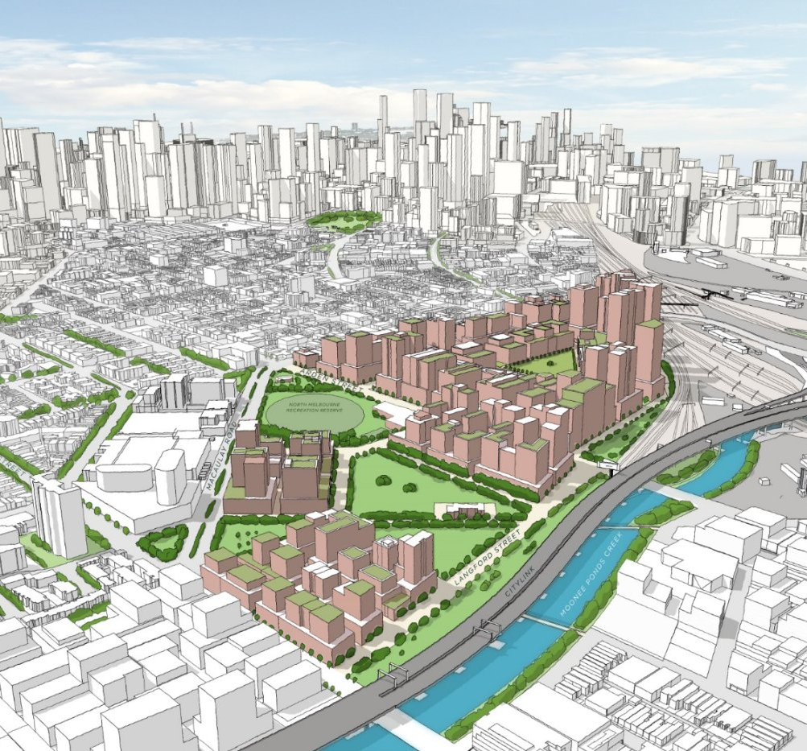
Arden Precinct Overview
About the Arden Precinct area
The southern site includes:
180,000 m² of land for development
22 lots including homes, offices, schools and a hospital
Sustainability goal orientated requirements with reduced truck movements and high waste diversion

Slide 11
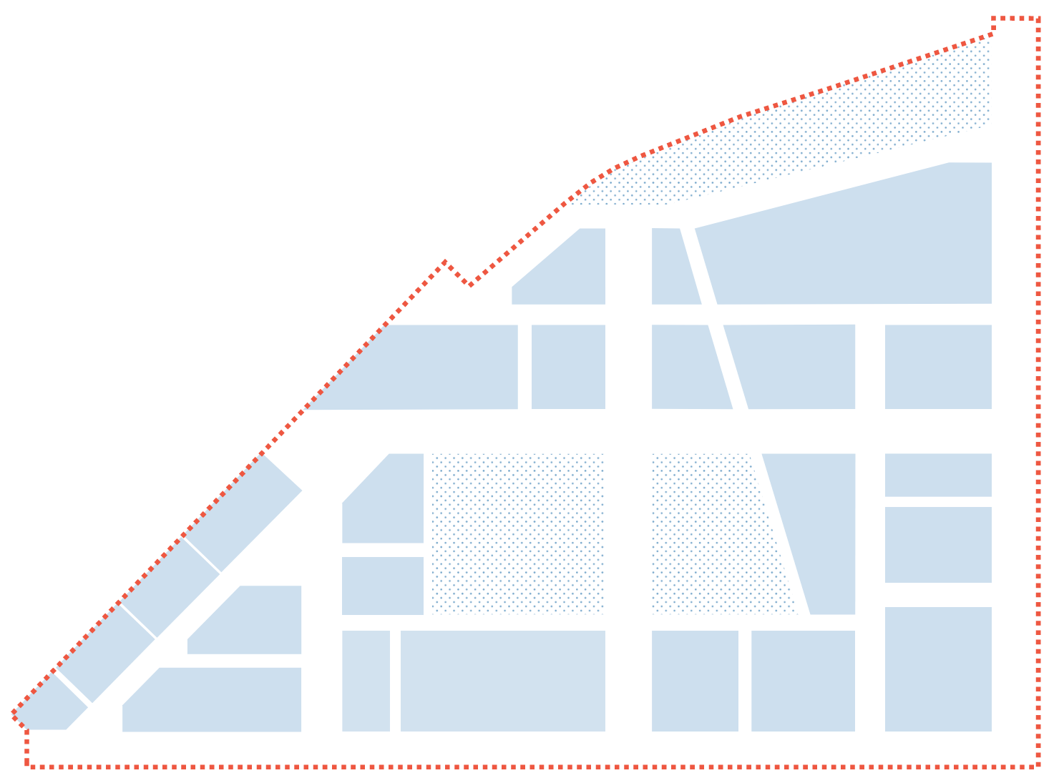
Arden Precinct
Legend
Residential
Commercial/Sector
Education
Hospital
Park
$
$
$
$
$
$
$
$
$
$
$

Slide 12
Business as Usual
Individual Docks Scenario
Deliveries and Waste trucks attend dock in each building
Approximately 300 waste truck movements per week
URRC

Slide 13
Shared Docks
Clustered Scenario
Deliveries and Waste trucks attend one dock in a cluster of buildings
Approximately 90 waste truck movements per week
40% Vehicle free streets
URRC

Slide 14
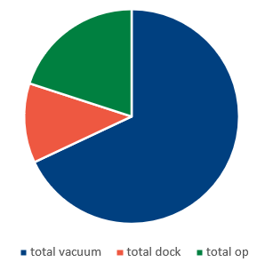
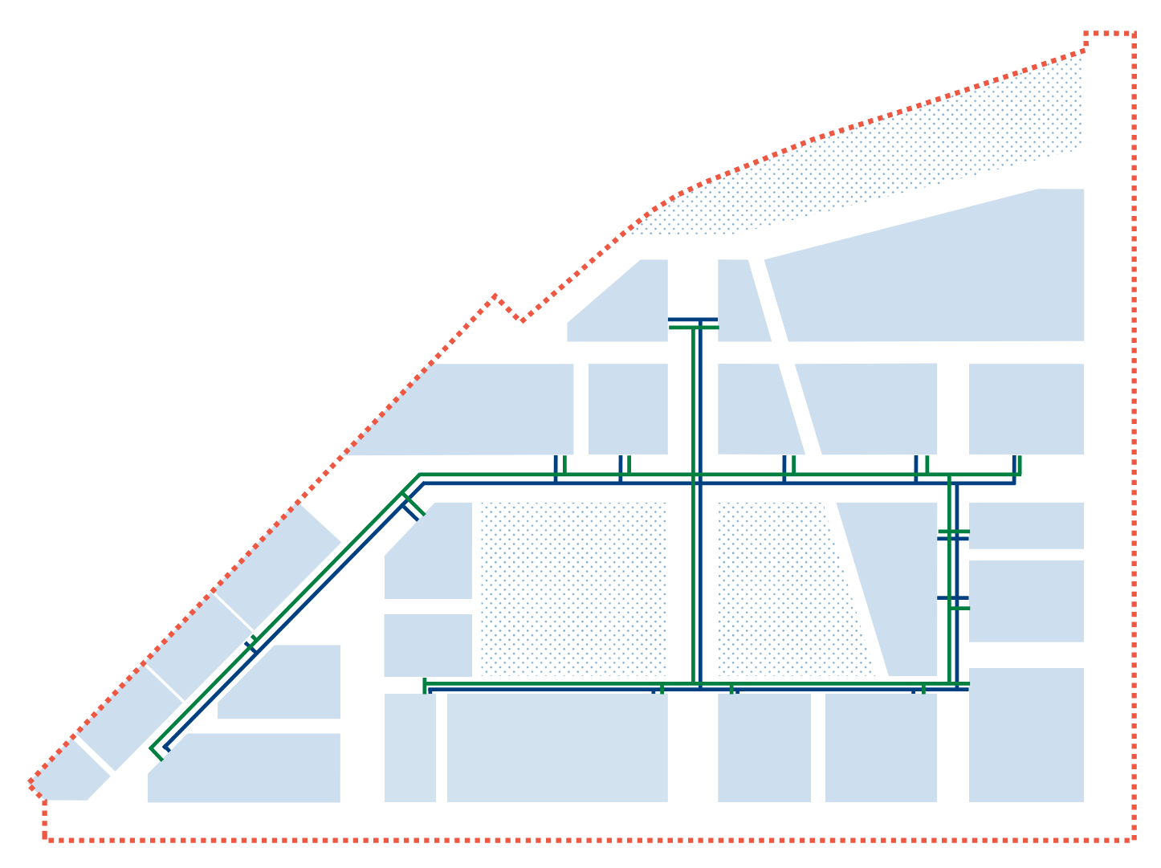
Vacuum and Pipe System
Smaller, shared docks required.
Approximately 20 waste truck movements per week
40% Vehicle free streets
Vacuum removes 70% of waste vehicles
Organics pipe removes 20% of waste vehicles
Only 10% of waste removed using vehicles
URRC
TERMINATION POINT

Slide 15
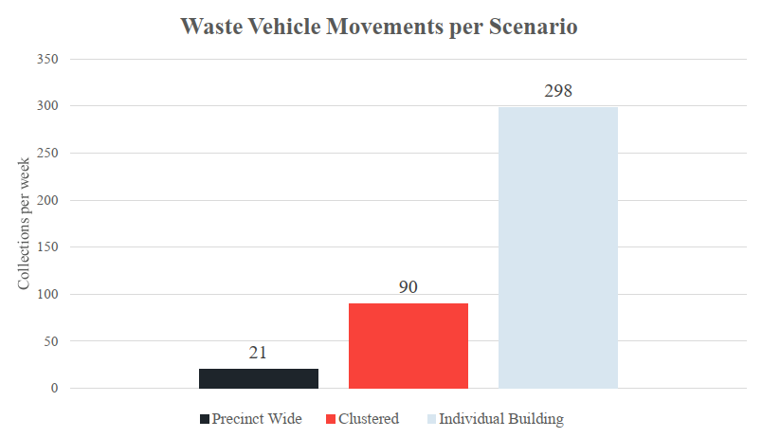
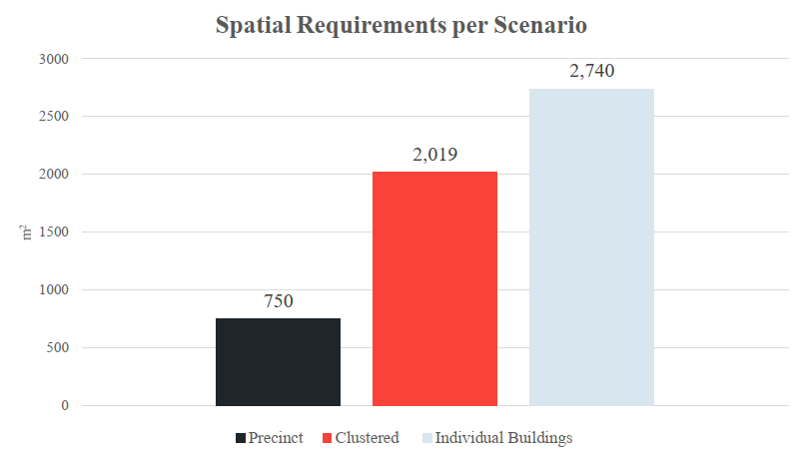
Space and Vehicle Savings

Slide 16
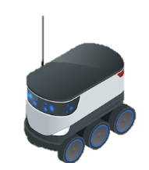
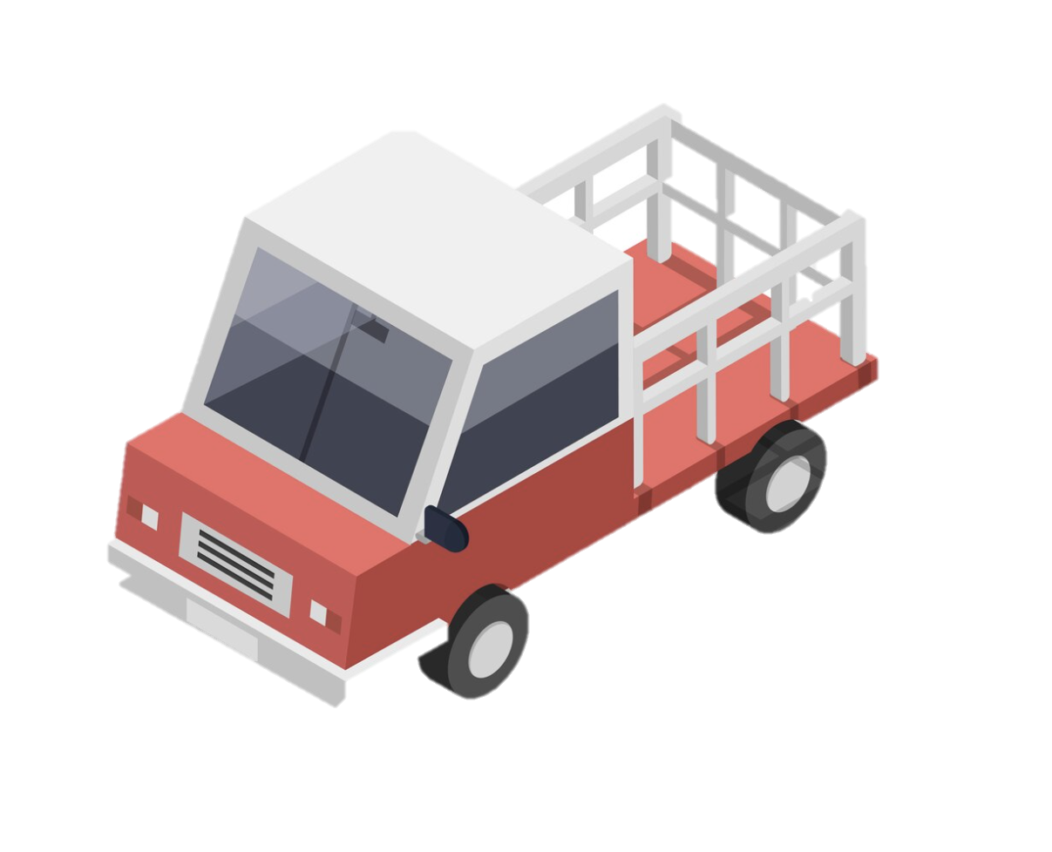
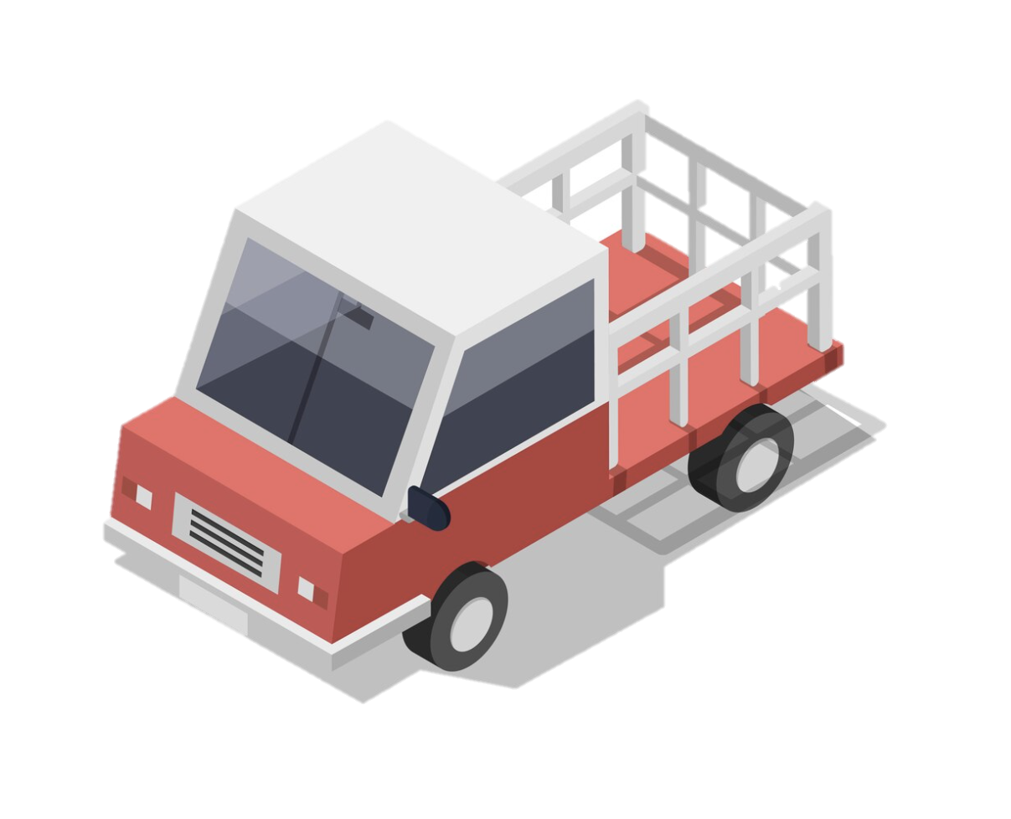
Waste Collection in a Vehicle Free City
Advantages
Reduced trucks
Reduced waste management space
Higher resource recovery
Disadvantages
Infrastructure Cost
Infrastructure Ownership
Early Planning Required
Planning Scheme Instruments
URRC

Slide 17
Thank you
Maree Marshall – Director
Waste Management and Circular Economy
WSP Australia
Maree.Marshall@wsp.com
0458 066 864

